Slide 1
Executive Presentation Narrative Storytelling

Slide 2
Business Objective
Before building the dashboard, the primary question was:
What operational decisions should this analysis support?
This solution was designed to support three strategic decision areas:
Academic performance monitoring
Intervention staffing allocation (Tier 2 & Tier 3)
Testing cost management and forecasting
The model connects student assessment performance directly to staffing and financial impact — moving from academic data to operational planning.

Slide 3
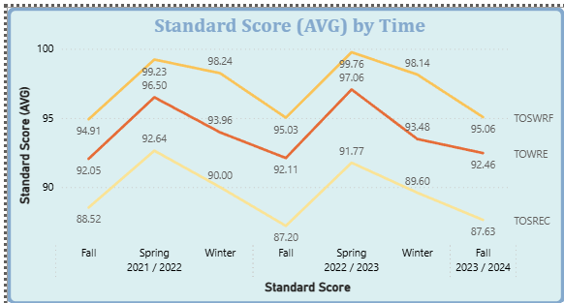
Sheet 1 — Academic Performance Overview
Executive Story: Is academic performance healthy? Where are the intervention risks? Key Findings
1. Performance Trend
Scores follow a cyclical seasonal pattern.
Spring consistently shows peak performance.
Fall performance is structurally lower but not declining year-over-year.
No structural academic deterioration observed.
👉 Interpretation: Variation is seasonal, not systemic.

Slide 4
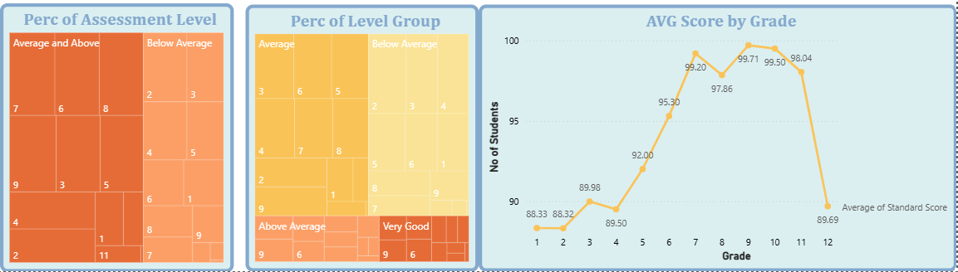
Sheet 1 — Academic Performance Overview 2. Performance Distribution
Over 50% of students fall into higher performance categories.
Lower grades (especially Grade 1) show elevated intervention risk.
Performance distribution strengthens n upper grades (Grade 5+).
👉 Strategic implication: Early-grade intervention yields the highest long-term academic ROI.

Slide 5
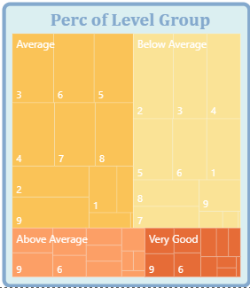
Sheet 1 — Academic Performance Overview
3. Intervention Exposure
A meaningful portion of students fall into Below Average or Average.
This directly impacts Tier 2 and Tier 3 staffing demand.
👉 This sheet establishes academic health and intervention concentration.

Slide 6
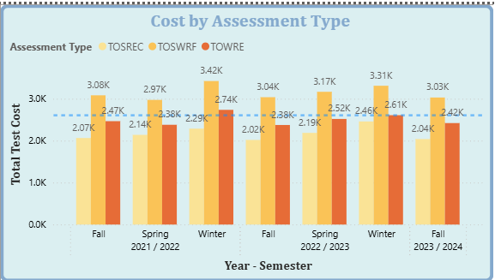
Sheet 2 — Cost Overview & Allocation
Executive Story: Is spending aligned with enrollment patterns?
Key Findings
1. Cost Drivers by Assessment Type
TOSWRF generates the highest total cost.
Cost dominance is driven by both price per test and volume.

Slide 7
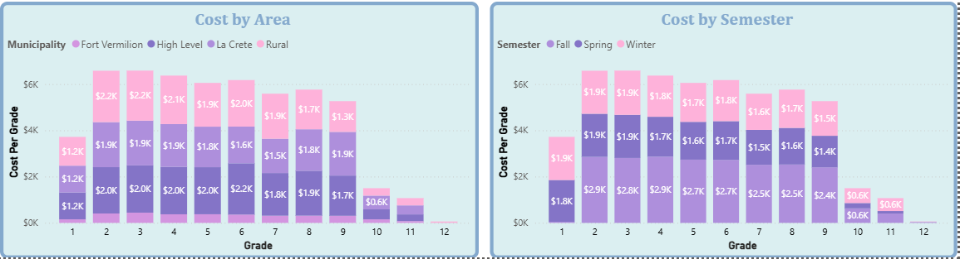
Sheet 2 — Cost Overview & Allocation
2. Cost by Grade & Region
• Grades 2–3 generate the highest total testing cost.
• Rural schools show higher cost allocation.
• Fall semester incurs a higher total testing cost.
👉 Cost concentration aligns with enrollment density and testing cycles.

Slide 8
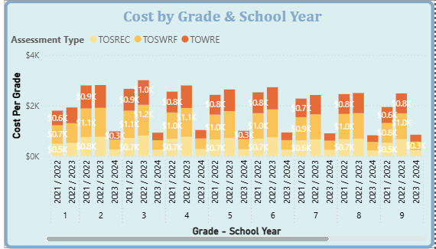
Sheet 2 — Cost Overview & Allocation
3. Cost Trend Stability
• Cost fluctuations follow student population trends.
• No abnormal structural cost inflation detected.
• Changes are volume-driven, not price-driven.
👉 Financial controls appear stable.

Slide 9
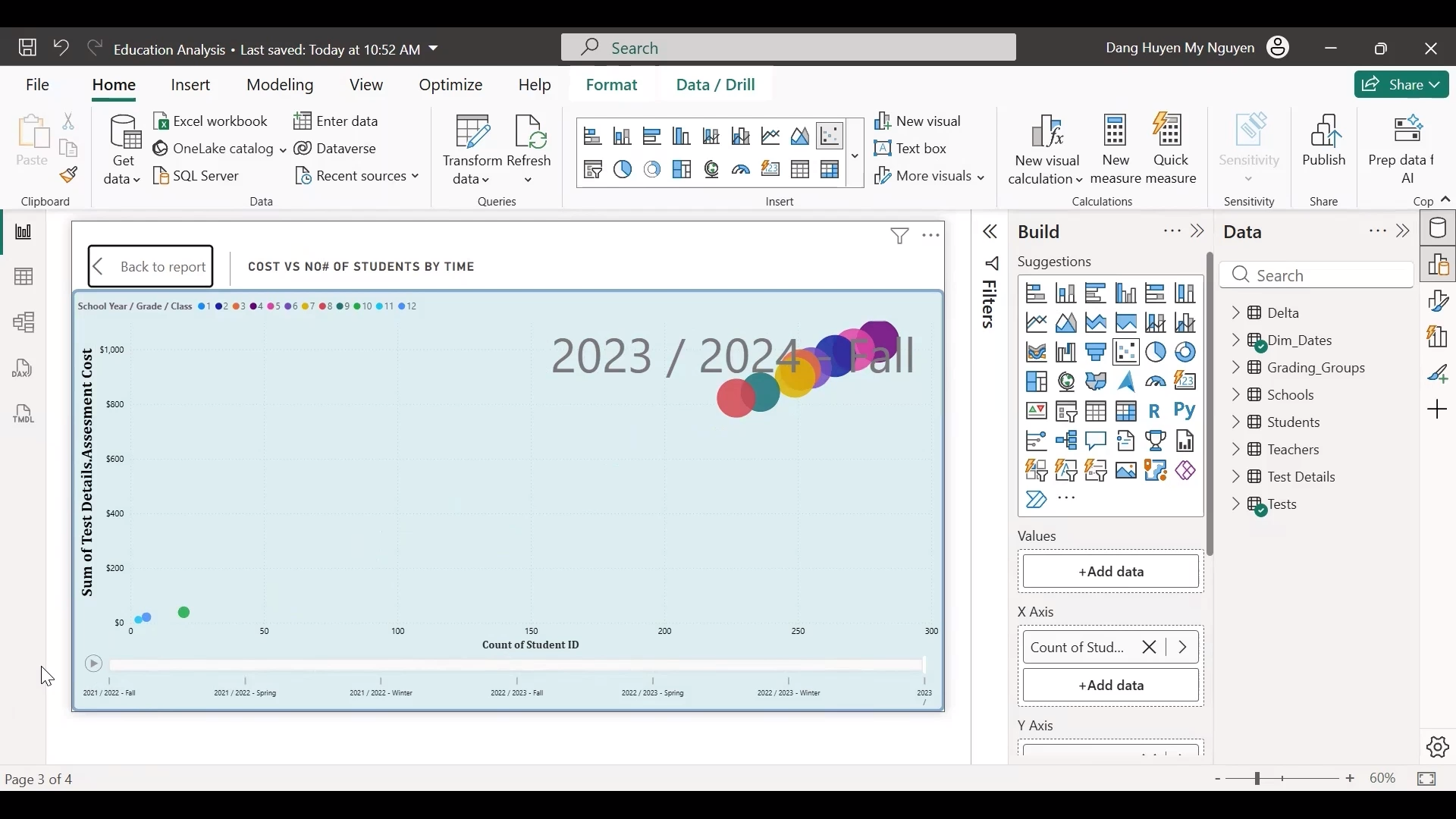

Sheet 3 — Cost Efficiency & Diagnostic Analysis
Executive Story: WHY is cost high? Is it inefficiency or scale?
Key Findings
Play
• Higher-cost grades correlate strongly with higher enrollment.

Slide 10
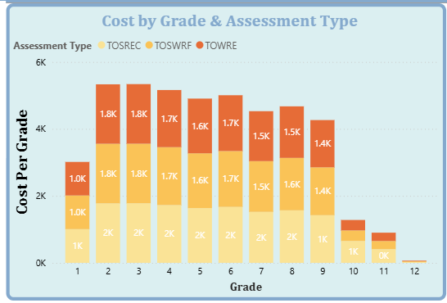
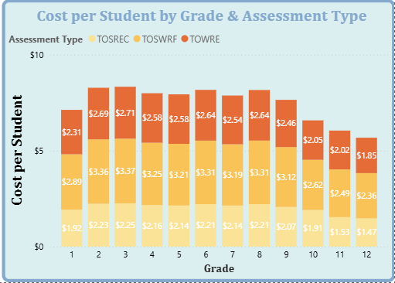
Sheet 3 — Cost Efficiency & Diagnostic Analysis
• Cost per student is elevated in Grades 2–9.
• Test volume (not pricing anomalies) explains the cost increase.
• Upper grades show unstable enrollment patterns.
👉 Insight:
Cost increases are scale-driven, not operational inefficiency.
This reframes the conversation from “reduce cost” to “plan for enrollment shifts.”

Slide 11
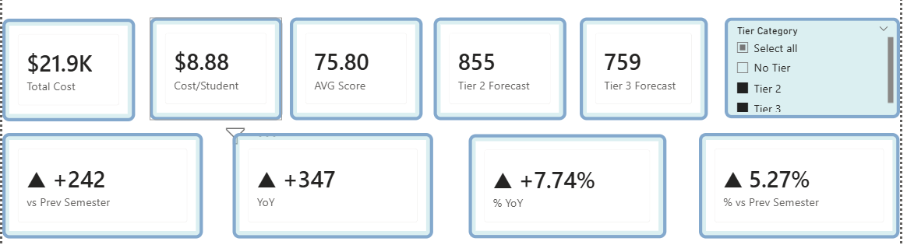
Sheet 4 — Executive Summary
Executive Story: What is the overall operational impact?
Key Findings
1. Performance & Cost Snapshot (Top KPI Cards)
Total Testing Cost: $21.9K
Cost per Student: $8.88
Average Score: 75.80
Tier 2 Forecast: 855
Tier 3 Forecast: 759
Insight:
This layer provides immediate visibility into performance health, financial exposure, and projected intervention demand.

Slide 12
Sheet 4 — Executive Summary
Executive Story: What is the overall operational impact?
Key Findings
2. Performance Momentum Indicators
• +242 students vs Previous Semester
• +347 students Year-over-Year
• +7.74% YoY
• +5.27% vs Previous Semester
Insight:
Academic performance is showing positive short-term and year-over-year growth, reinforcing that current intervention strategies are effective.

Slide 13
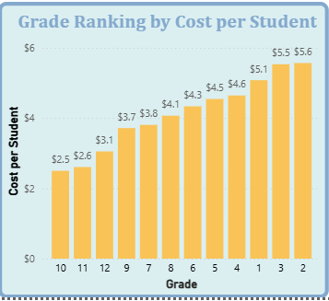
Sheet 4 — Executive Summary
Executive Story: What is the overall operational impact?
Key Findings
3. Cost Concentration by Grade
• Higher grades show lower per-student cost.
• Cost per student increases toward middle grades.
• Higher grades (1–3 range in chart) show the highest cost per student.
Insight:
Cost intensity varies by grade level, suggesting different testing frequency or assessment mix across grade bands.

Slide 14
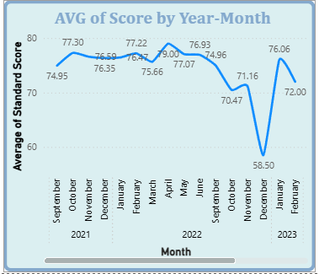
Sheet 4 — Executive Summary
Executive Story: What is the overall operational impact?
Key Findings
4. Score Trend Over Time
Average Score by Year-Month
• Scores follow a cyclical academic pattern.
• Noticeable dip during late 2022.
• Recovery trend observed in early 2023.
Insight:
Performance volatility is time-bound and seasonal rather than structurally declining.

Slide 15
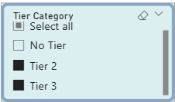
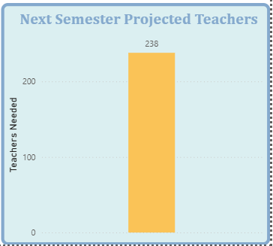
Sheet 4 — Executive Summary
Executive Story: What is the overall operational impact?
Key Findings
5. Next Semester Teacher Projection
Projected Teachers Needed: 238
Insight:
Staffing forecast is directly tied to Tier 2/Tier 3 projections and intervention ratios.
This is where forecasting logic directly translates into workforce planning decisions.

Slide 16
Forecasting Logic Consideration
A critical modeling distinction was identified:
1,423 distinct students across 3 semesters
≠ (Sem 1 + Sem 2 + Sem 3) = 2565 ÷ 3 per semester (tier 2 as an example)
Why?
• DISTINCTCOUNT across all semesters counts each student once.
• AVERAGEX calculates the distinct count per semester, sums them, and then averages.
Incorrect aggregation would significantly underestimate intervention demand and staffing requirements.

Slide 17
Forecasting Model Comparison
Two approaches evaluated:
A. 3-Semester Rolling Average Provides stable smoothing.
B. Delta % Change Model More responsive to recent acceleration trends.
Example impact:
20-student forecast difference
Equivalent to 2 teachers (10:1 Tier 2 ratio)
Underestimation directly affects workforce capacity.
Recommended approach: Use conservative hybrid forecasting for staffing allocation. In this report, a 3-semester rolling average is used.

Slide 18
Executive-Level Strategic Conclusions
• Academic performance is improving in the short term.
• Cost variations are primarily driven by enrollment volume.
• Per-student cost varies by grade level.
• Accurate, distinct-per-semester forecasting is critical for staffing precision.
• Workforce planning must align with intervention projections.

Slide 19
Business Impact
This executive dashboard enables leadership to:
• Monitor academic health at a glance
• Detect performance momentum
• Understand cost concentration drivers
• Forecast staffing requirements
• Reduce under-allocation risk in intervention planning

Slide 20
Technical Skills Demonstrated
• Integrated performance + cost + workforce model
• Advanced DAX (DISTINCTCOUNT, AVERAGEX, Delta logic)
• Forecast comparison modeling
• Time-based trend analysis
• Executive-level analytical storytelling

Slide 21
Final Thoughts
Accurate forecasting is not just about numbers —it directly impacts staffing, cost control, and student outcomes.
This project highlights how thoughtful modeling decisions can change real operational planning.
Thank you for your time.

